Slide 2
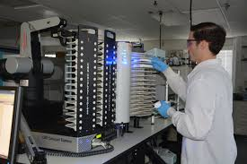
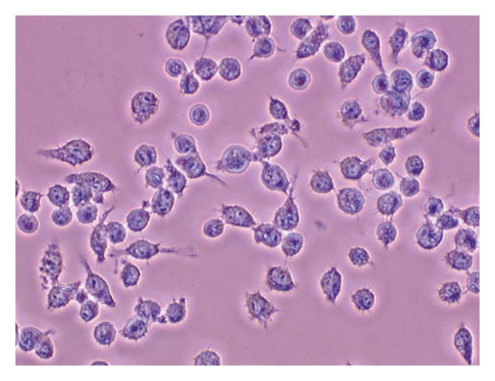


High-throughput screen
Validation: Cellular Activity
Optimization: QSAR
Pre-clinical and clinical trials

